Slide 1
Domain driven design
DDD

Slide 2
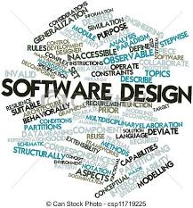

Slide 3
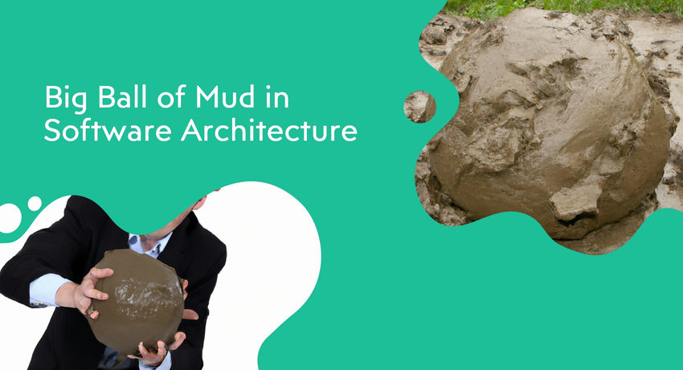
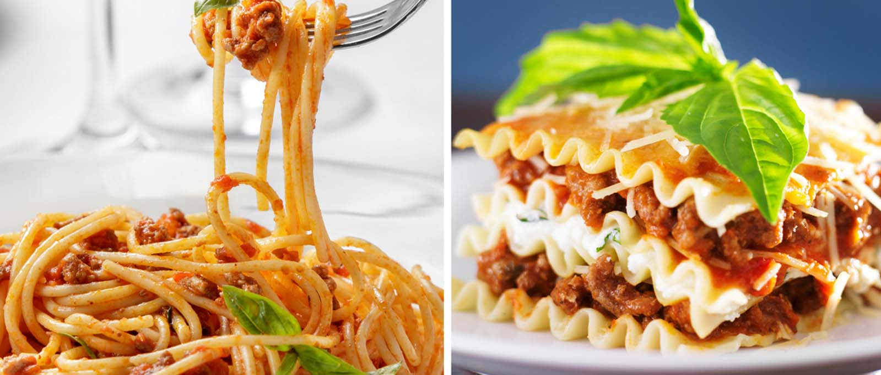
Big Boll Of Mud (BBOM)
The definition of BBoM, as defined by Brian Foote and Joseph Yoder in the paper “Big Ball of Mud,” is “… a haphazardly structured, sprawling, spaghetti‐code jungle.
An application that appears to have no distinguishable architecture (think big bowl of spaghetti versus dish of layered lasagna)

Slide 4
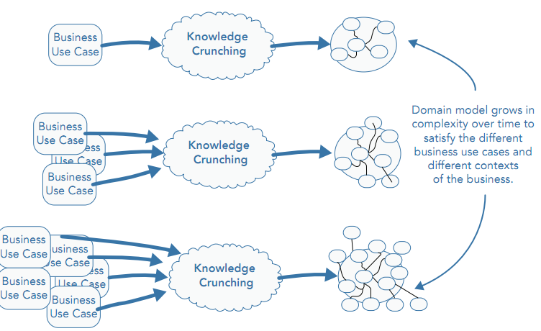
A Model Can Grow in Complexity
Notes:
Knowledge Crunching => bridging any knowledge gaps for the technical team when designing a solution for a problem domain

Slide 5
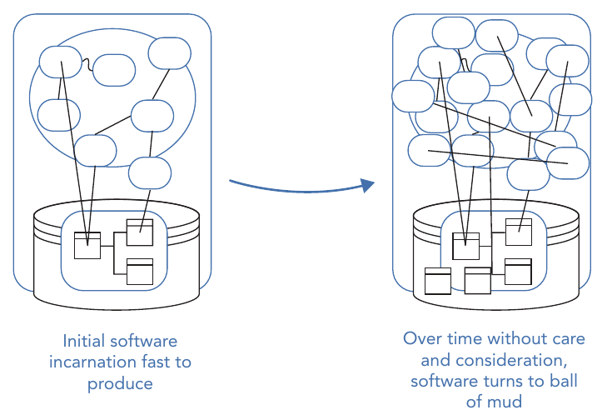
Big Ball of Mud (BBOM)

Slide 6
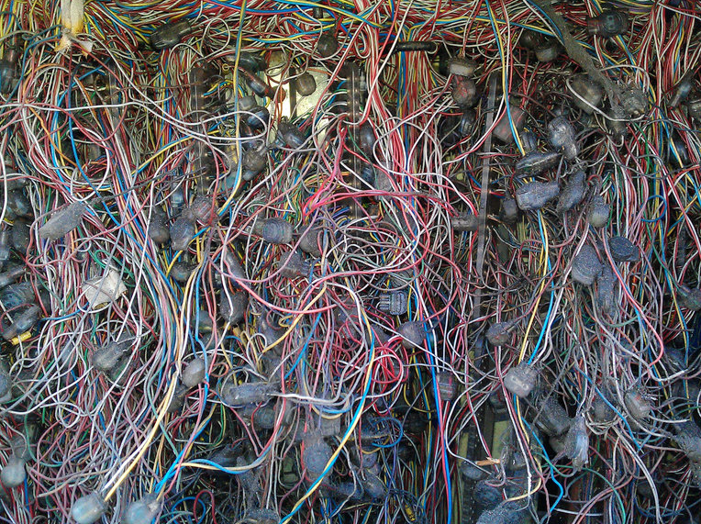
Big Boll Of Mud (BBOM)

Slide 7
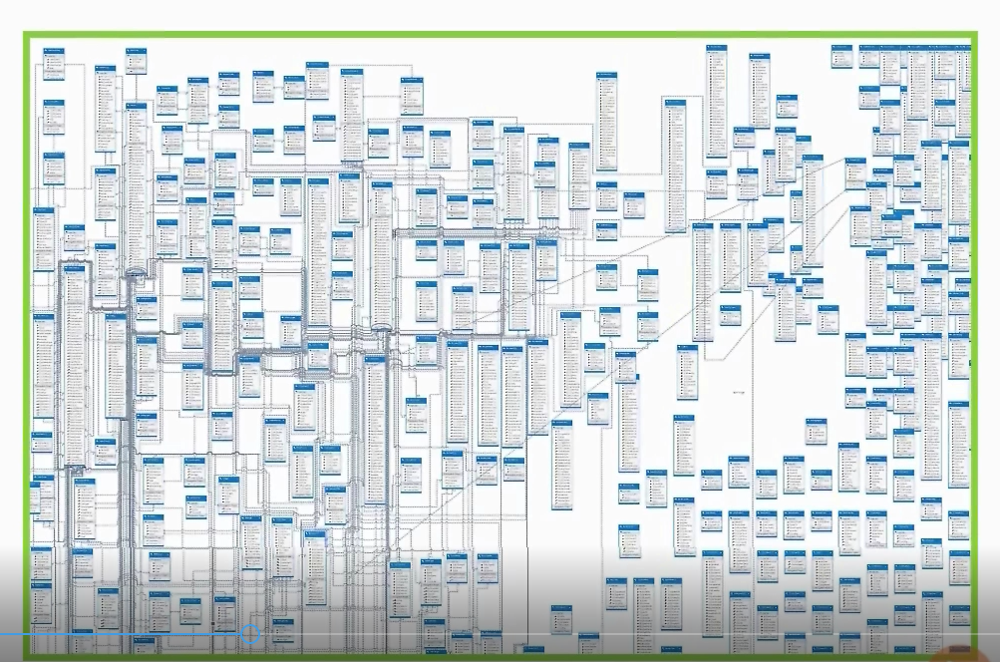
Big Boll Of Mud (BBOM)

Slide 8
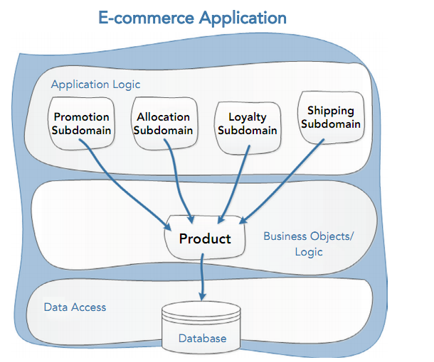
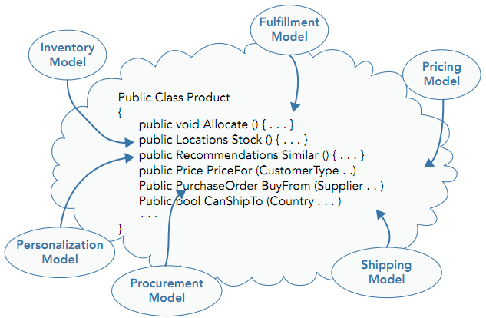
The Challenges of a Single Model
Notes:
increase cost of change , many team work on a same Source,Software Release depend on all teams

Slide 9
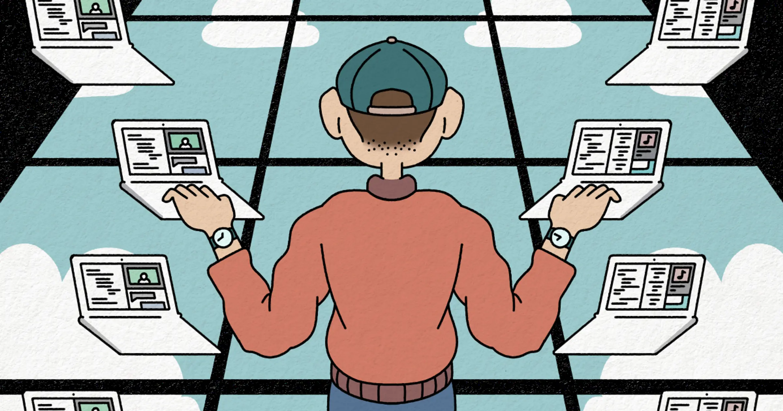
Developer Job
As a developer, you may think that your job is to write code?

Slide 10
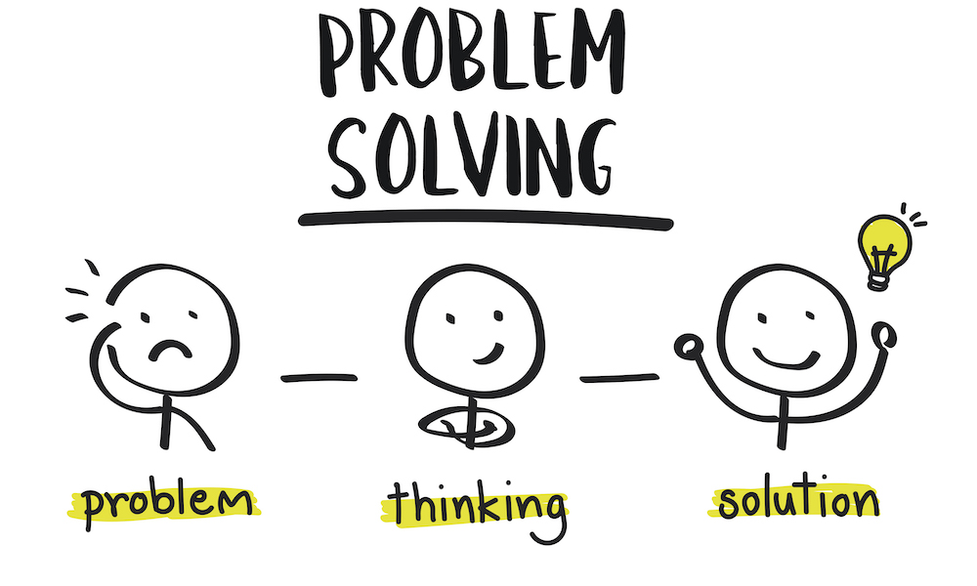
Developer Job
A developer’s job is to solve a problem through software, and coding is just one aspect of software development.

Slide 11
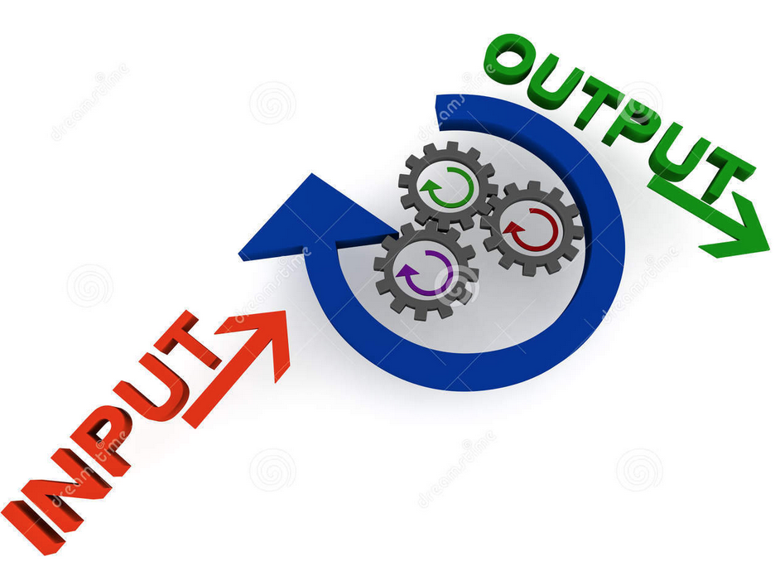
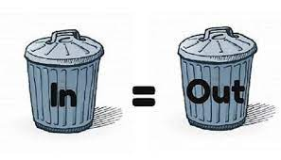
Software Development As Pipeline
If you think of software development as a pipeline with an input (requirements) and an output (the final deliverable), then the “garbage in, garbage out” rule applies. If the input is bad (unclear requirements or a bad design), then no amount of coding can create a good output

Slide 12
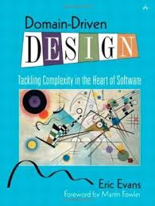
DDD Birth
2003
Eric Evans

Slide 13
What Is DDD
DDD is an approach to design software with complex bussiness
The most significant complexity of many application IS NOT technical
We must focus more on the business concerns

Slide 14
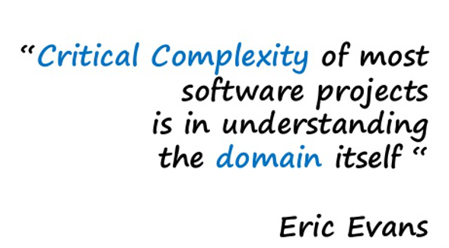

Slide 15
DDD Patterns
Strategic Patterns: The strategic patterns of DDD distil the problem domain and shape the architecture of an application.
Tactical Patterns : The tactical patterns of DDD, also known as model building blocks, are a collection of patterns that help to create effective models for complex bounded contexts

Slide 16
What is Domain
The domain represents the problem area you are working within.
A sphere of knowledge or activity.

Slide 17
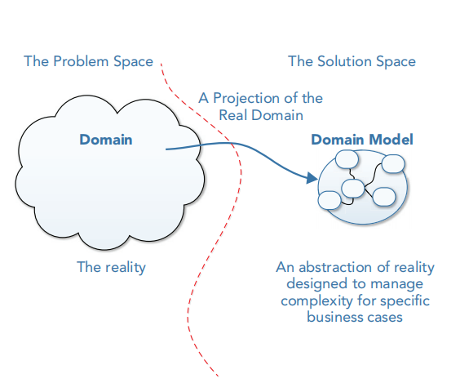
What Is Domain Model

Slide 18
What Is SubDomain
Sub part of business domain(area of expertise)
Has own language
There are 3 type of sub domain(Core,Supporting,Generic)
Notes:
next UL

Slide 19
Core Domain
The core parts of the system represent the fundamental competitive advantage that your company can gain through the delivery of this software.
Best Quality Of Design
Best Developers
Most Focus and Effort
Notes:
next Supporting

Slide 20
Supporting Domain
subdomain, which is less valuable for business than Core domain. Without it business may be can even survive for some time. But it still is quite important (supports core domain), it also is specific for the domain and has to be developed
Notes:
next CoreDomain

Slide 21
Generic Domain
subdomain which is less valuable for business than Core domain. It also is generic enough to allow buying it off the shelf (unlike supporting domain)
Notes:
next CoreDomain

Slide 22
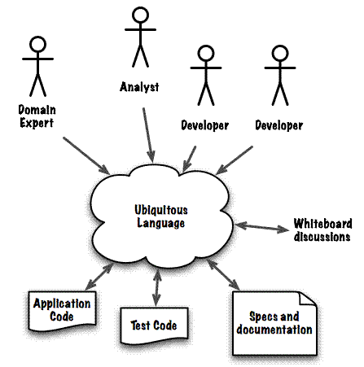
Ubiquitous Language
Notes:
next CoreDomain

Slide 23

Domain exploraton
DDD

Slide 24
Knowledge crunching
Knowledge crunching is key to bridging any knowledge gaps for the technical team when designing a solution for a problem domain based on a set of requirements

Slide 25
PATTERNS FOR EFFECTIVE KNOWLEDGE CRUNCHING

Slide 26
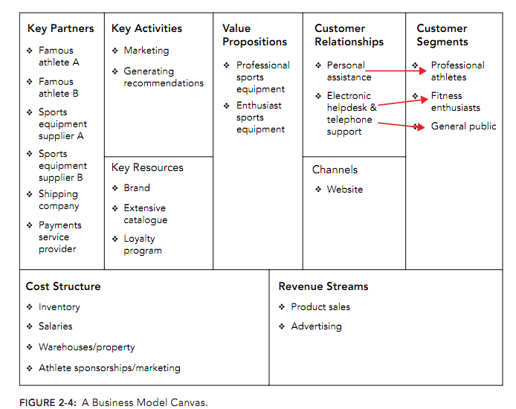
Understanding the Business Model
A business model contains lots of useful domain information goals of a business

Slide 27
Focus on the Most Interesting Conversations
Don’t bore domain experts and business stakeholders by going through a list of requirements with them one item at a time
Start with the areas of the problem domain that keep the business up

Slide 28
Start from the Use Cases
A use case lists the steps required to achieve a goal, including the interactions between users and systems

Slide 29
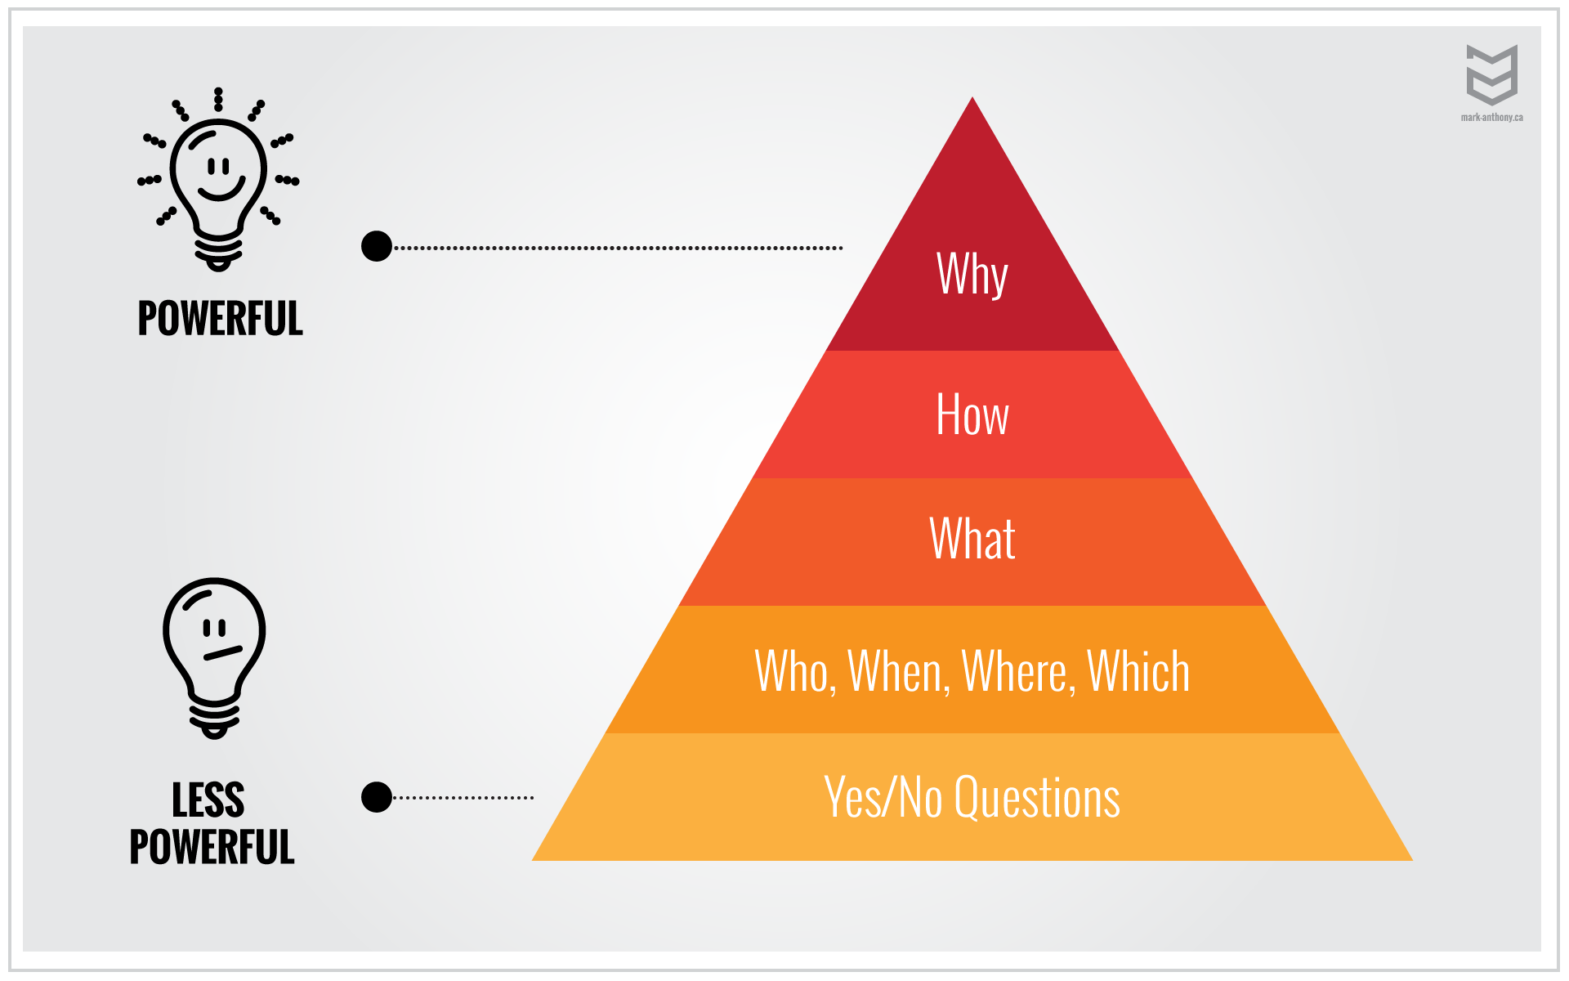
Ask Powerful Questions
What is the success criteria of this product?
What is the business trying to achieve?

Slide 30

Sketching
People often learn quicker by seeing visual representations of the concepts they are discussing

Slide 31
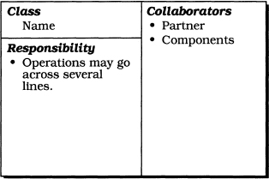
Class Responsibility Collaboration (CRC) Cards
A class name, which represents a concept in the domain
The responsibilities of the class
Classes that are associated and are required to fulfill its purpose

Slide 32
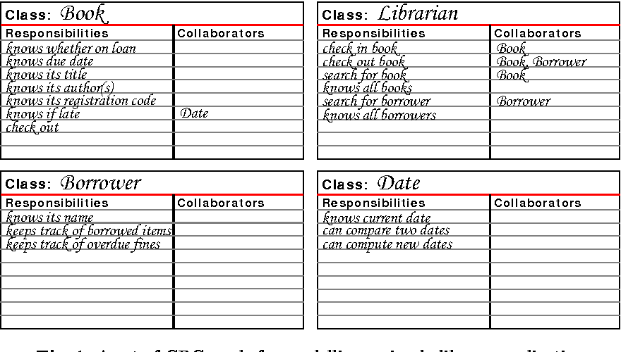
CRC Cards

Slide 33
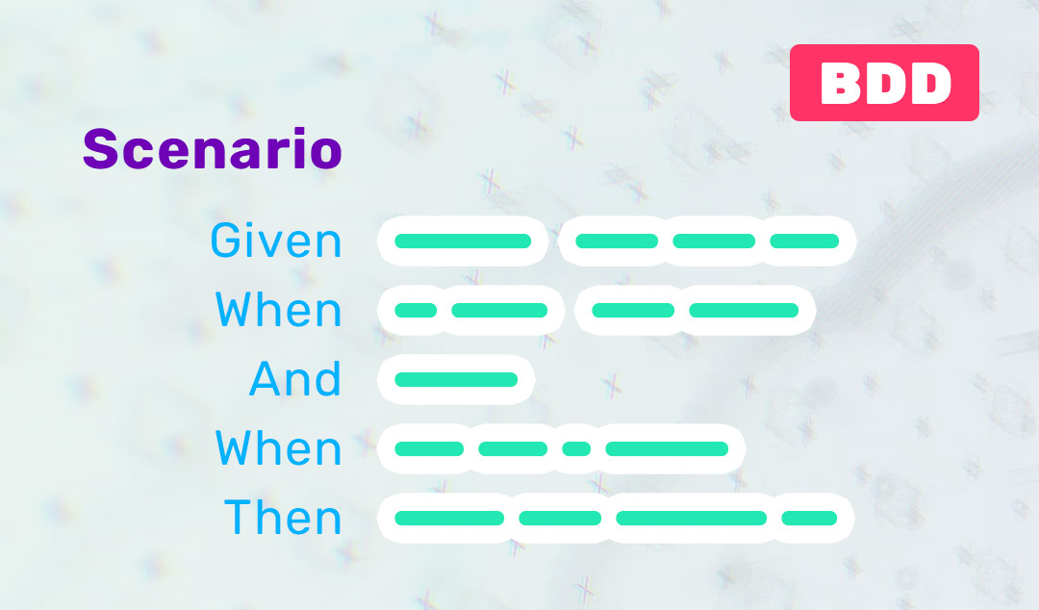
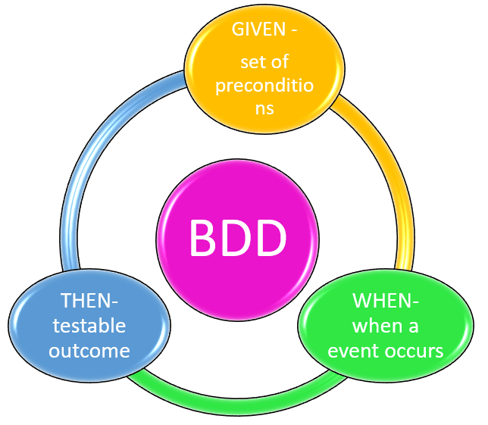
Behavior‐Driven Development
BDD uses concrete domain scenarios during conversations with domain experts and stakeholders to describe the behaviors of a system

Slide 34
An example of a BDD scenario
Scenario: Customer satisfies the spend threshold for free delivery
Given: Threshold for free delivery is set at $60
And: I am a customer who has a basket totaling $50
When: I add an item to my basket costing $11
Then: I should be offered free delivery

Slide 35
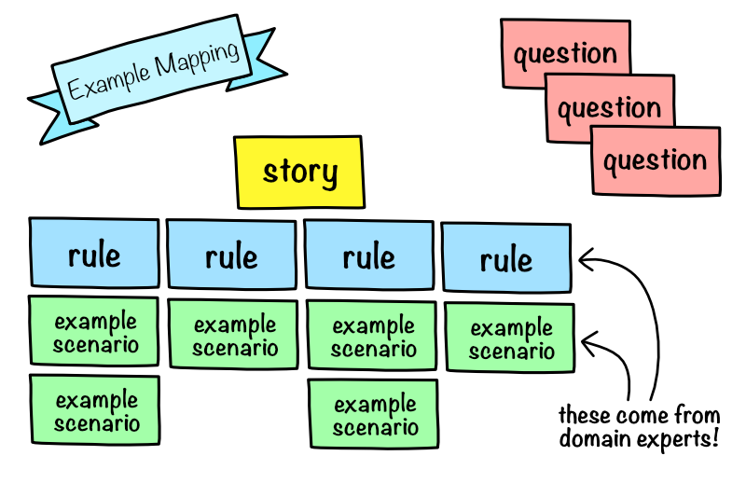
Example Mapping

Slide 36
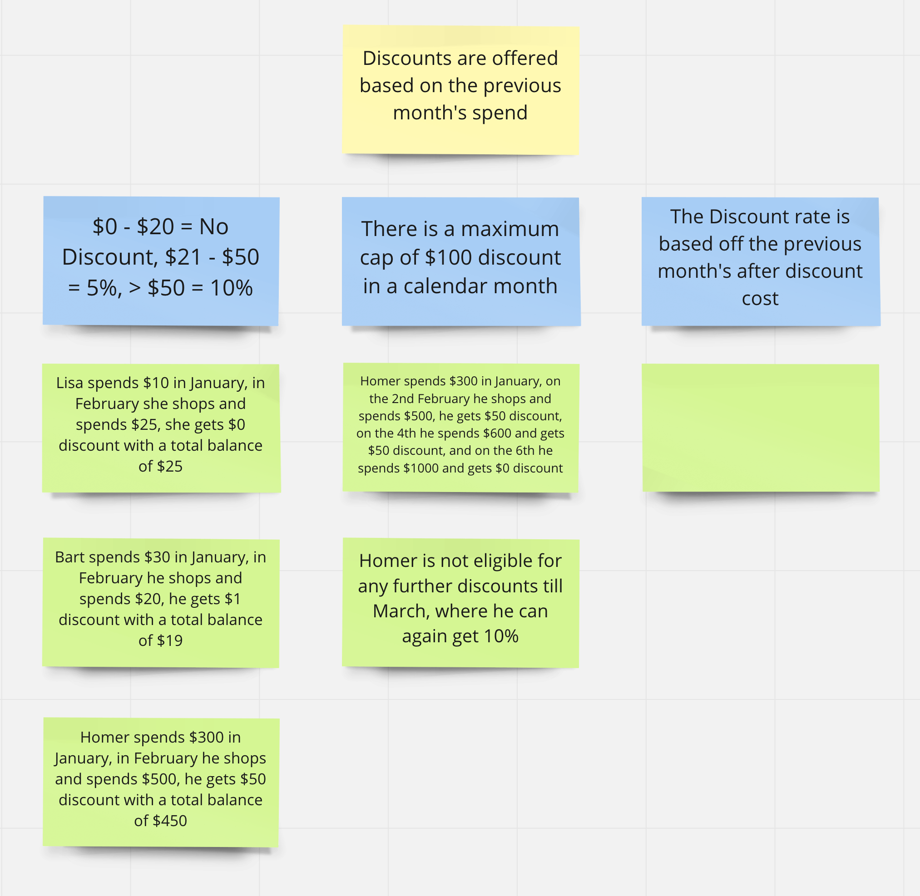

Slide 37
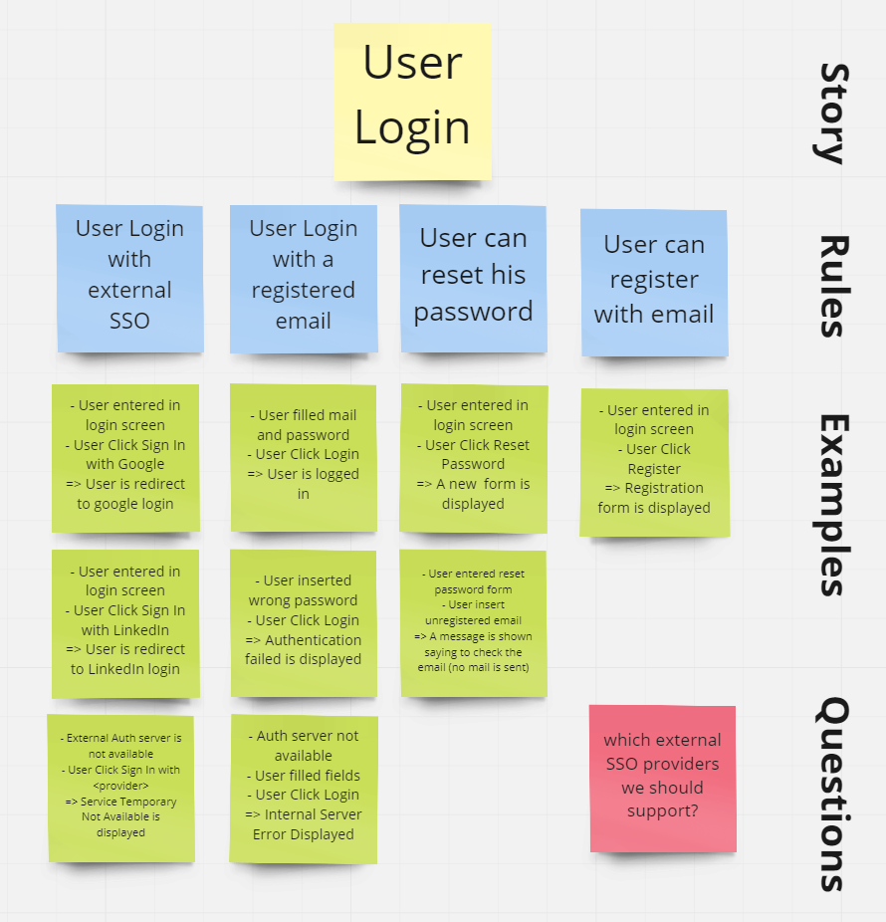

Slide 38
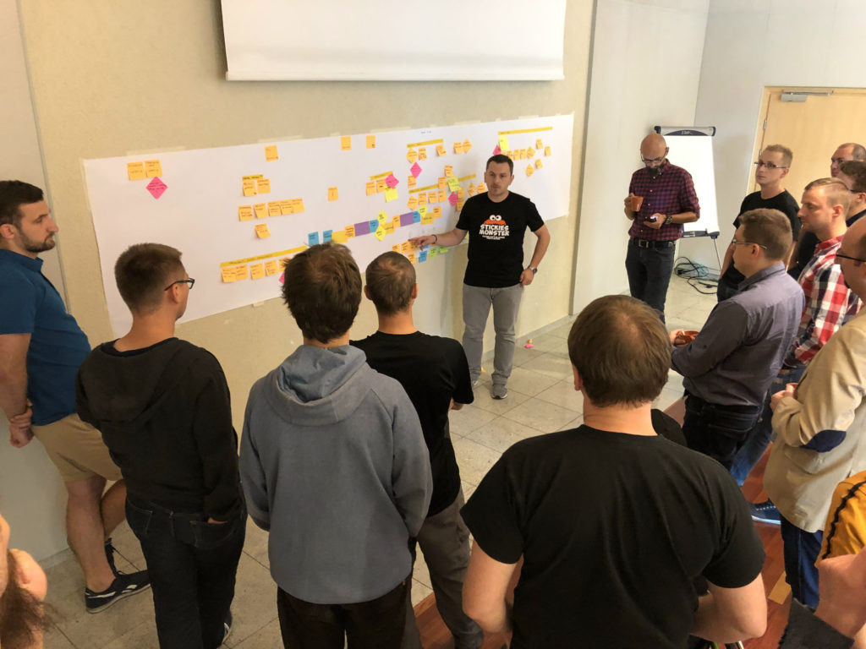
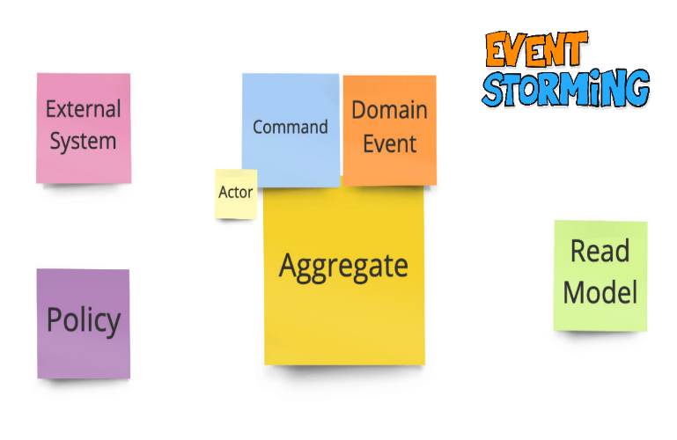
Event Storming
Event Storming is a workshop activity that is designed to quickly build an understanding of a problem domain in a fun and engaging way for the business and development teams

Slide 39

Workshop Demo

Slide 40
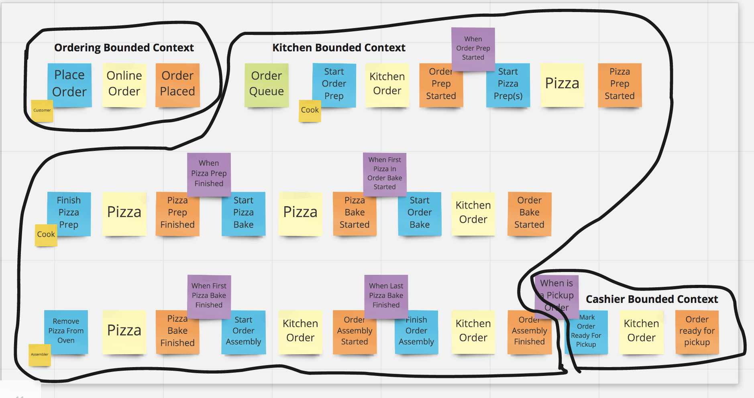
Workshop Result

Slide 41
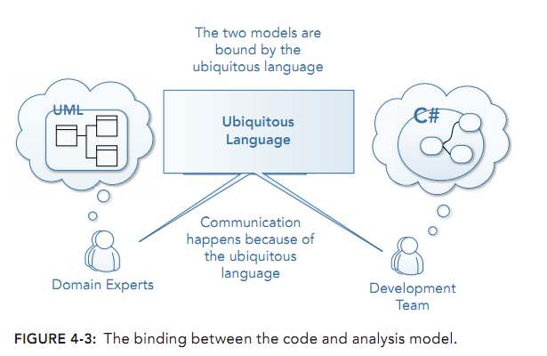
MODEL‐DRIVEN DESIGN
Model‐Driven Design is the process of binding an analysis model to a code implementation model, ensuring that both stay in sync and are useful during evolution

Slide 42
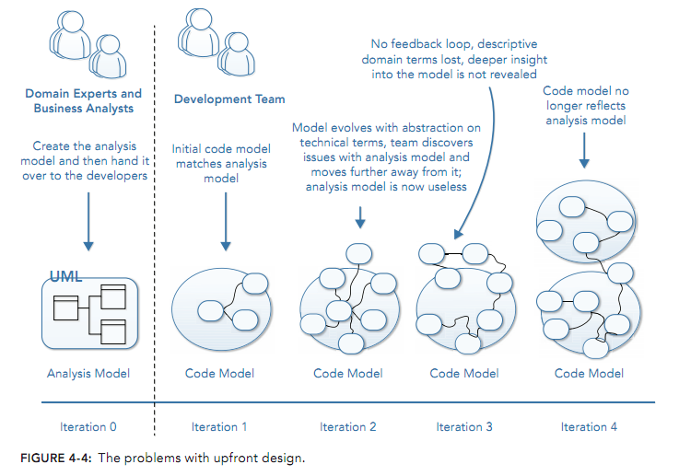
The Challenges with Upfront Design

Slide 43
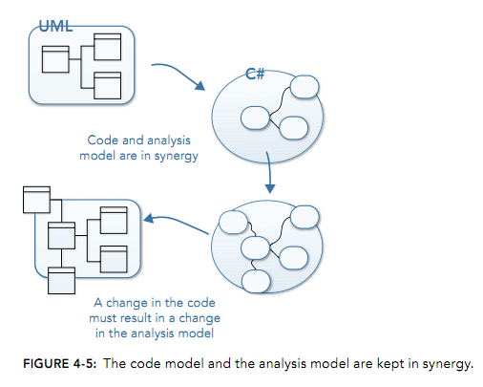
code model and the analysis model are kept in synergy

Slide 44
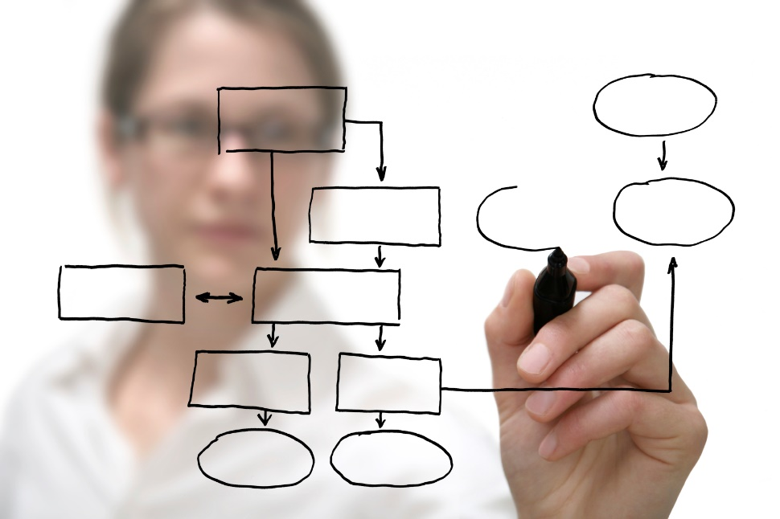
Strategic PATTERNS
DDD

Slide 45
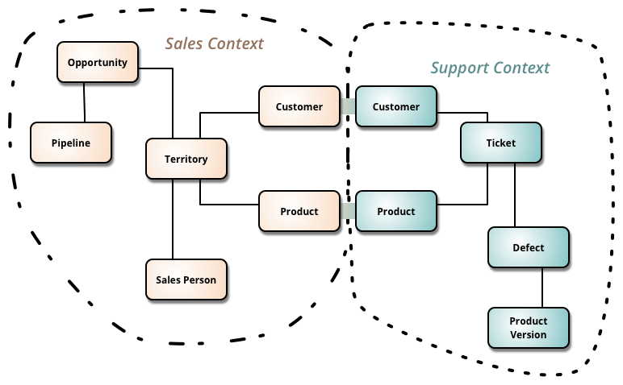
Bounded Context

Slide 46
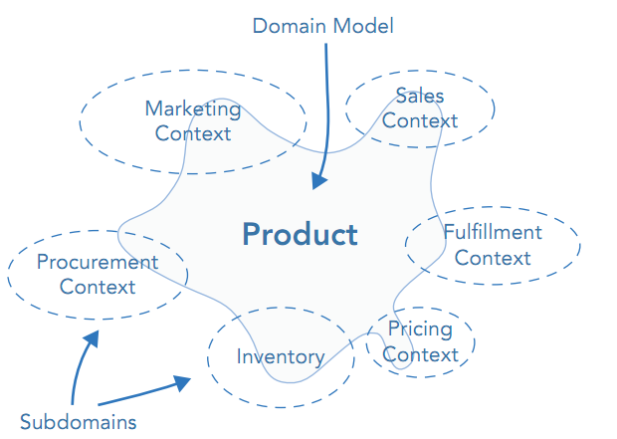
Bounded Context

Slide 47
Bounded Context
There is one Ubiquitous Language per Bounded Context.
A Bounded Context is large enough only to capture the complete Ubiquitous Language of the isolated business domain, and no larger.

Slide 48
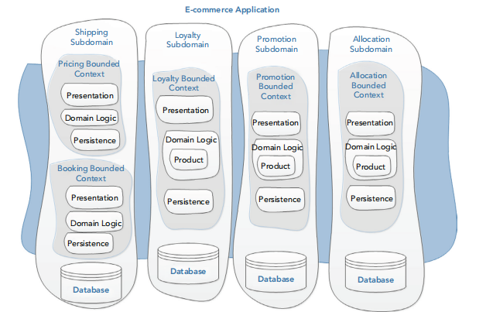
Bounded Context

Slide 49
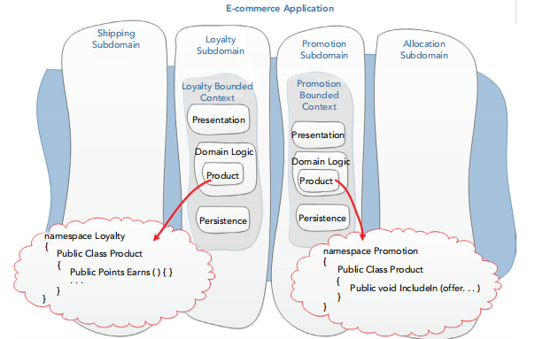
Bounded Context

Slide 50
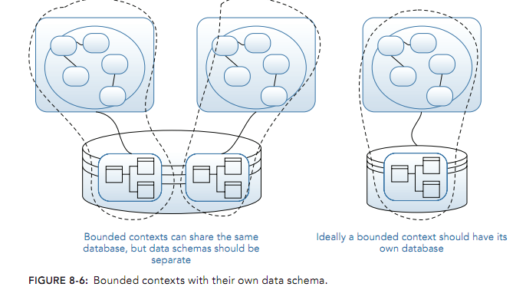
Bounded Context

Slide 51
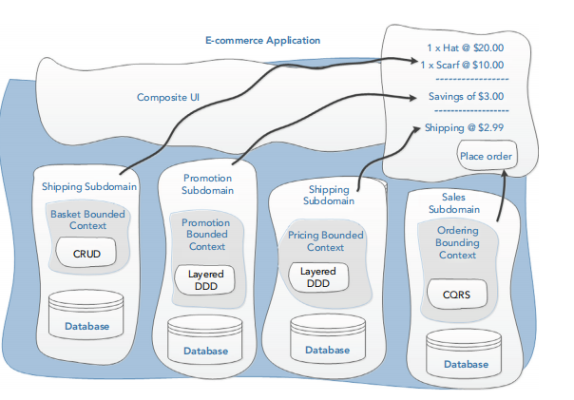
Composit UI
A composite UI is a user interface made up of loosely coupled components. A composite UI shows data from multiple bounded contexts on the same web page.

Slide 52
Context Map
It’s allows you to identify the relationship between bounded contexts and the relationship between the teams that are responsible for them.

Slide 53
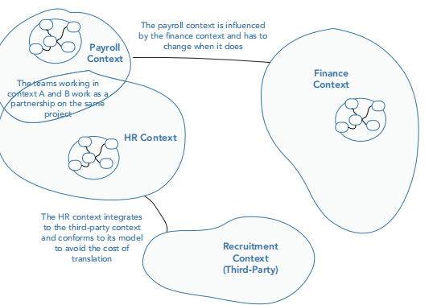
Context Map

Slide 54
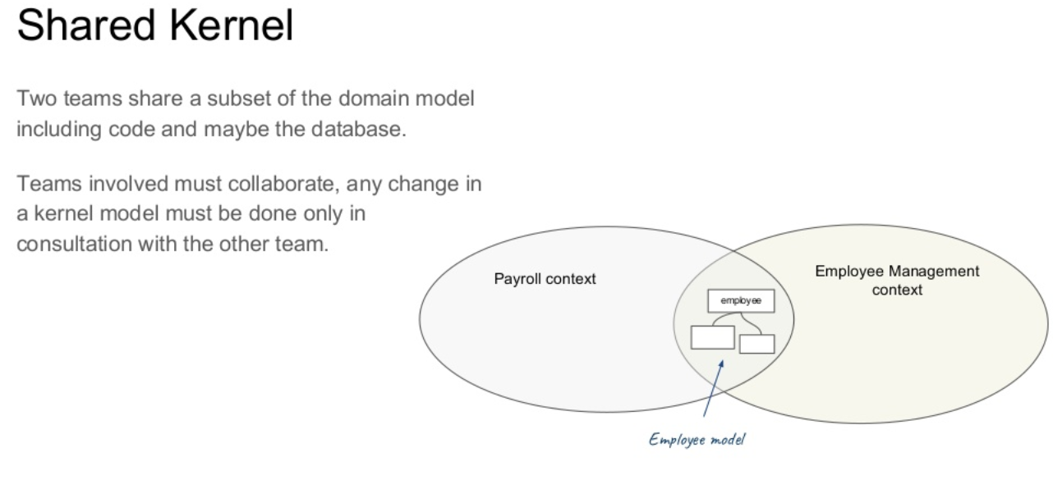

Slide 55
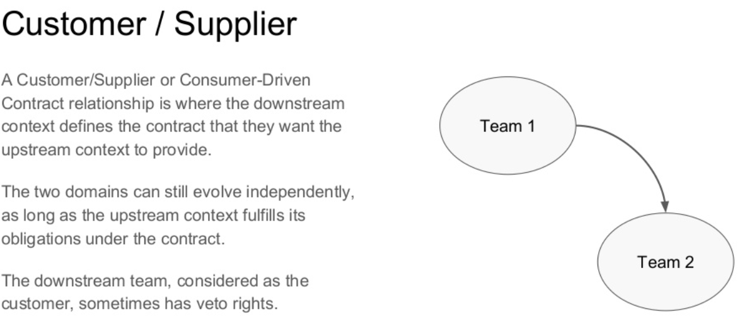

Slide 56
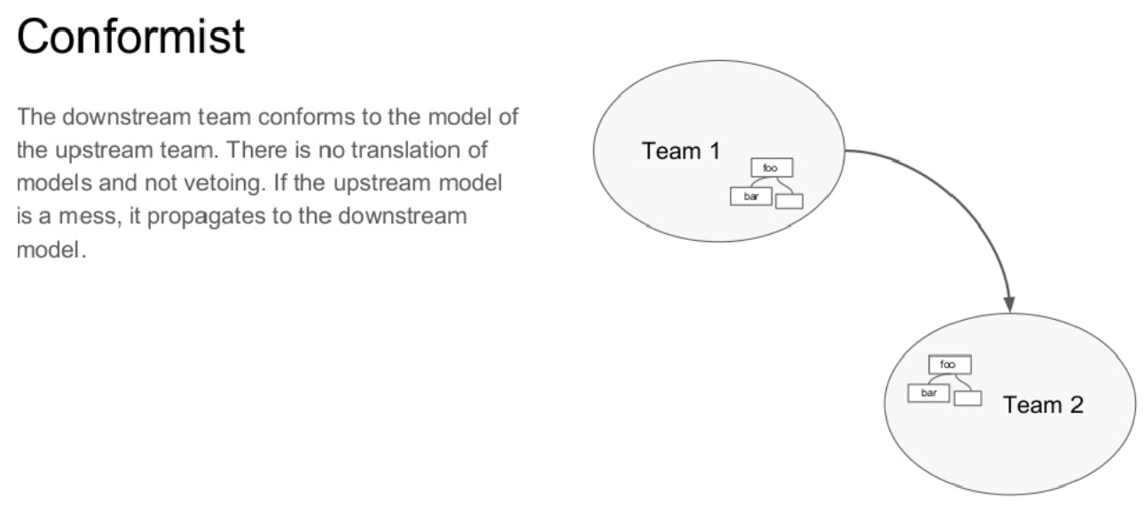

Slide 57
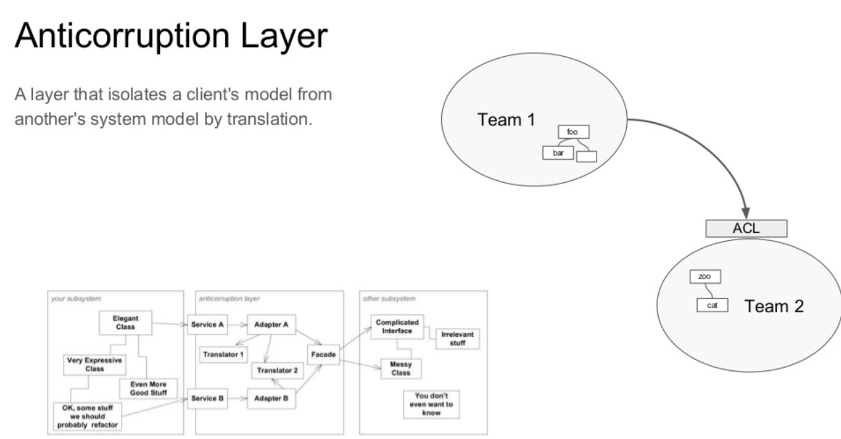

Slide 58
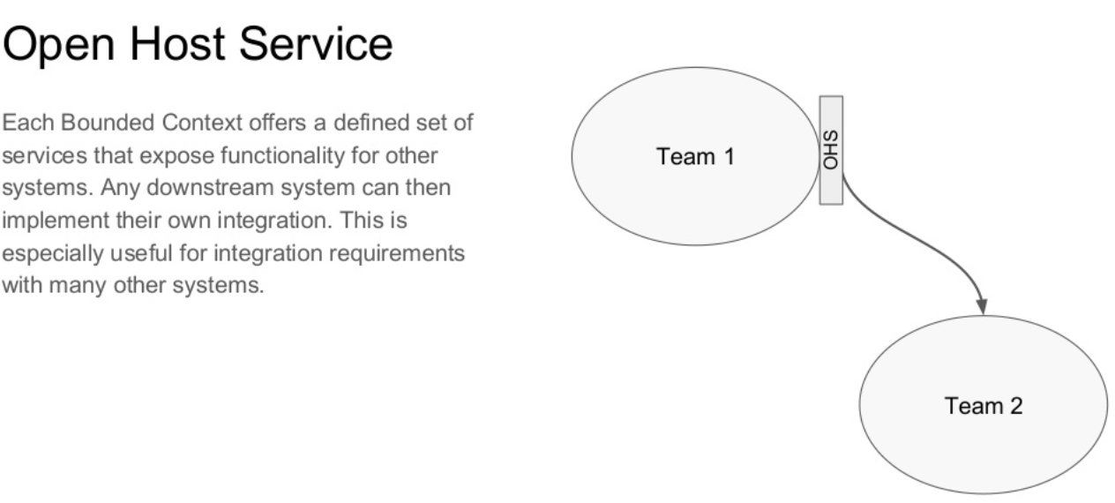

Slide 59
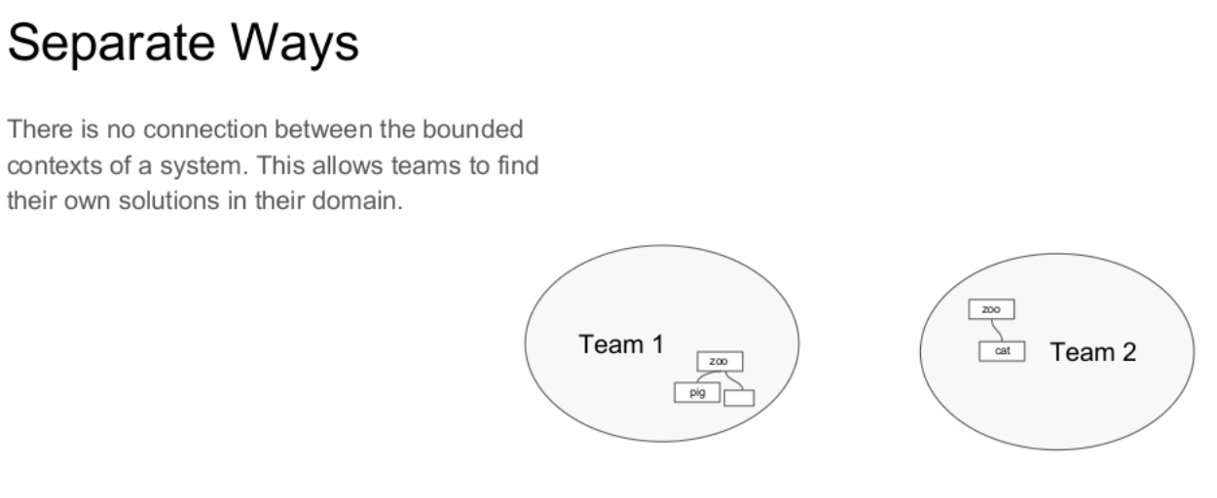

Slide 60
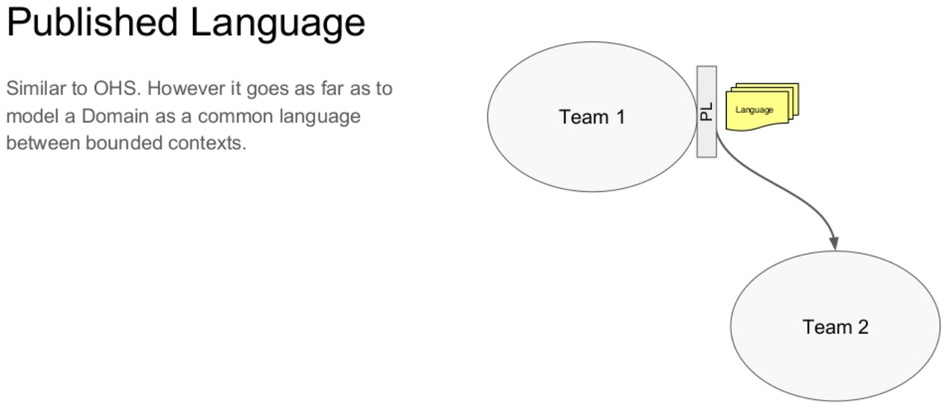

Slide 61
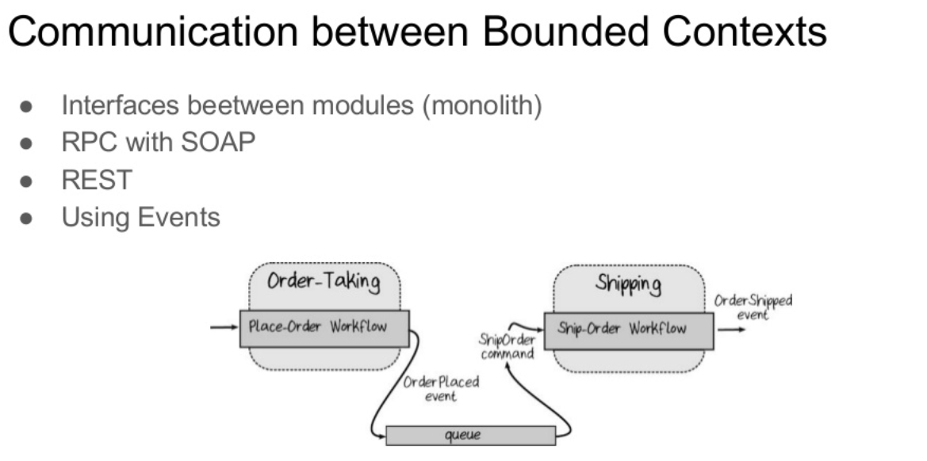

Slide 62

TACTICAL PATTERNS
DDD

Slide 63
Entity
An entity represents a concept in your domain that is defined by its identity rather than its attributes. Although an entity’s identity remains fixed throughout its lifecycle, its attributes may change
Notes:
A person will have a different age over the time but he/she will remain the same person
An account with diffence balance

Slide 64
Entity
An entity represents a concept in your domain that is defined by its identity rather than its attributes. Although an entity’s identity remains fixed throughout its lifecycle, its attributes may change
Has Identity
Identity ‐Based Equality
Has life cycle in system
Notes:
A person will have a different age over the time but he/she will remain the same person
An account with diffence balance

Slide 65
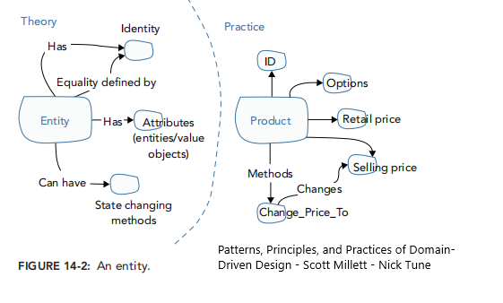
Entity

Slide 66
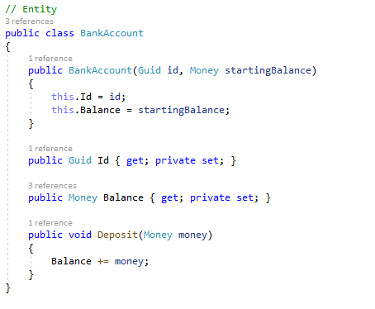
Entity

Slide 67
Value Object
Value objects represent the elements or concepts of your domain that are known only by their characteristics;
they are used as descriptors for elements in your model;
they do not require a unique identity.
Identity‐Less
Immutable
Attribute‐Based Equality
Self‐Validating

Slide 68

Value Object
Notes:
Product -> Color (RGB) , NationalityCode

Slide 69

Value Object

Slide 70
Aggregate
Aggregate is a cluster of domain objects that can be treated as a single unit.
It’s a transactional boundries for object graphs.
An example may be an order and its line-items, these will be separate objects, but it's useful to treat the order (together with its line items) as a single aggregate.

Slide 71
Aggregate root
An aggregate root, acts as the entry point into the aggregate.
Aggregates represent domain concepts, not just generic collections of domain objects
Align aggregate boundaries with domain invariants to help enforce them
Notes:
Optimistic(versioning contol) and Pessimistic(Row lock) concurrency

Slide 72
Invariant
An invariant is a business rule that must always be consistent.
Notes:
Association != Aggregate
Make Aggregate around invariants
Order (has order item, has customer)
Invariant = Order mus has Customer, Order item must has product , Order has limitation on sum order items amount
1- Customer as aggregate root?
2- Order as aggregate root?

Slide 73


Slide 74

Notes:
Blue Book page:130

Slide 75
Aggregate Design Rules
Desigine Small Aggregate
Allowing Only Roots to Have Global Identity
Domain objects outside the aggregate can only hold a reference to the aggregate root ID
Only aggregate roots can be obtained directly with database queries
An aggregate must be fully persisted or fully rolled back within a transaction to retain consistency
Notes:
-This large-cluster Aggregate will never perform or scale well
-The correct minimum is however many are necessary, and no more.
-

Slide 76
Aggregate Design Rules
No domain objects outside the boundary of the aggregate can hold a reference to internal objects
Transactions should, ideally, not cross aggregate boundaries
There can be inconsistencies between aggregates; use domain events to update aggregates in a separate transaction
When an aggregate is deleted all the domain objects within it must be removed as well

Slide 77
Service
DDD

Slide 78
Different Services
Domain Services
Application Services
Infrastructure Service

Slide 79
Domain Service
When a significant process or transformation in the domain is not a natural responsibility of an Entity or Value Object, add an operation to the model as a standalone interface declared as a Service.
A Service in the domain is a stateless operation that fulfills a domain-specific task.
Notes:
User Repository in domain service

Slide 80
Avoiding Anemic Domain Models
Be careful not to push too much logic into domain services
Low conceptual cohesion

Slide 81
Domain Events
Use a Domain Event to capture an occurrence of something that happened in the domain. This is an extremely powerful modeling tool.

Slide 82
Factory
When creation of an object, or an entire Aggregate becomes complicated or eveals too much of the internal structure, Factories provide encapsulation.

Slide 83
Repository
A Repository commonly refers to a storage location.
A repository is used to manage aggregate persistence and retrieval while ensuring that thereis a separation between the domain model and the data model.

Slide 84


Slide 85


Slide 86
Architecture
DDD

Slide 87

Layered Architecture
Classic Layered Architecture :

Slide 88

Data-Driven Design
Notes:
Based on RDBMS , all business in SP ( Technology)
Generate Code from Database Table
Modeling in Relational world is hard
Single Table => Single model => share between Sub Systems

Slide 89
Architecture of DDD applications
DDD is that it doesn’t require the use of any specific architecture.
The goal is to use just the right choices and combinations of architecture and architectural patterns.

Slide 90
Architecture in DDD
Isolate the expression of the domain model and the business logic, and eliminate any dependency on infrastructure, user interface, or even application logic that is not business logic. Partition a complex program into layers.

Slide 91

Onion Architecture

Slide 92

Ports and Adapters ( Hexagonal ) Architecture
Notes:
-We have 2 types port. Inbound ( entry ) or outbound ( exiting)
-An inbound port defines the exposure of the core’s functionality
-An outbound port define the core’s view of the outside world
-The primary or Driving Adapters represents the UI. These adapters can use the inbound ports (interfaces) provided by the core application.
-The secondary or Driven Adapters represent the connection to your back-end databases, external libraries, mail API’s, etc. The secondary adapters are implementations of the outbound port

Slide 93

Dipendency Rule

Slide 94
The Domain Layer
The domain layer is where the Domain Model lives.
The domain layer doesn’t depend on any other layer.
The domain layer is agnostic to the technicalities of the clients it serves and data stores that persist the domain objects.

Slide 95
The Application Layer
Application services layer represent the use cases and behavior of the application. They contain application logic that coordinates the fulfillment of a use case by delegating to the domain layer and infrastructural layers.
Notes:
Bussiness Workflow

Slide 96
The Application Layer
Common responsibilities of application layer
Client of the domain layer
Coordinating the retrieving of domain objects from a data store (like repositories).
Control persistence transactions
Control Security

Slide 97
Application Logic vs Business Logic
Application logic contains the workflow steps require to fulfill a business use case. It’s all about coordination and orchestration through delegation to domain and infrastructural services.
Domain logic on the other hand is focused only with domain rules, concepts, information and work flows.

Slide 98
Rule of application service design
Application Services remain very lightweight, coordinating operations performed against domain objects.
If our Application Services become much complex, it is probably an indication that domain logic is leaking into the Application Services.

Slide 99
The Infrastructural Layers
The infrastructural layers of an application are the technical details that enable it to function :
Implementation of storing information.
Calling web service or provide message endpoints.
provide capabilities for logging, security, notification and…

Slide 100
Dependency Inversion Principle
Using DIP enables both the Domain and Infrastructure to depend on abstractions defined by the domain model.

